Slide 1
aako CNC
MANUFACTURING FACILITY
SHOP FLOOR
CERTIFICATES AND AWARDS
About
SAMPLES

Slide 2
1.We are equipped With Five Vertical Machining Centers
(VMC) , Moreover we have Measuring instruments up to 300 mm
like GMT Granite surface table, Digital Height gauge ,Digital Verniers ,
Micrometer and Bore gauges, Air gauges.
2. We are capable of designing and manufacturing of fixtures ,Cutting
tools and Gauges used in CNC machine shop.
3 .AN ISO 9001 – 2015 (From TUV SUD) & 100 PPM Certified
Company (From HYUNDAI).
4. Twenty years experience in CNC machine Shop.
5. GST and ESI Registered Company
CERTIFICATES AND AWARDS
MANUFACTURING FACILITY
SHOP FLOOR
SAMPLES
About

Slide 3
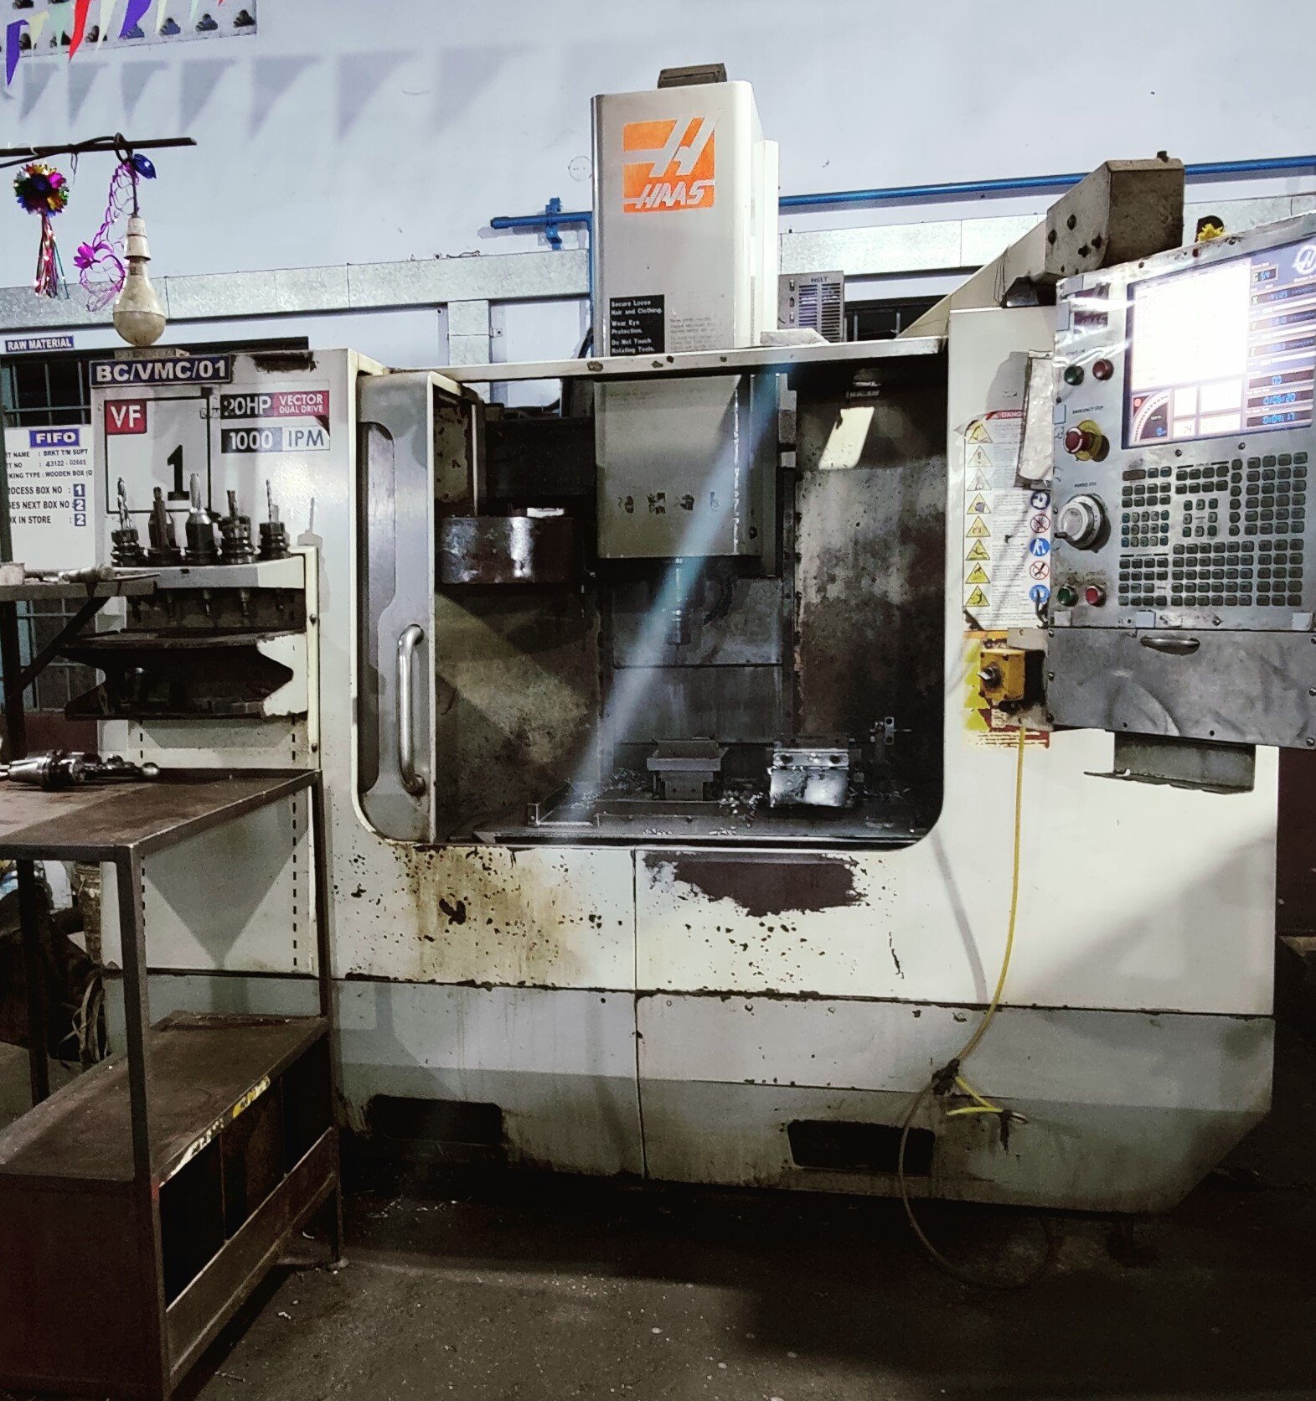
CERTIFICATES AND AWARDS
SAMPLES
SHOP FLOOR
About
MANUFACTURING FACILITY
MACHINE NAME :- VMC
MAKE & MODEL :- HAAS VF1 (USA)
CONTROL :- HAAS
CAPACITY :- 610 X 410X 510 MM

Slide 4
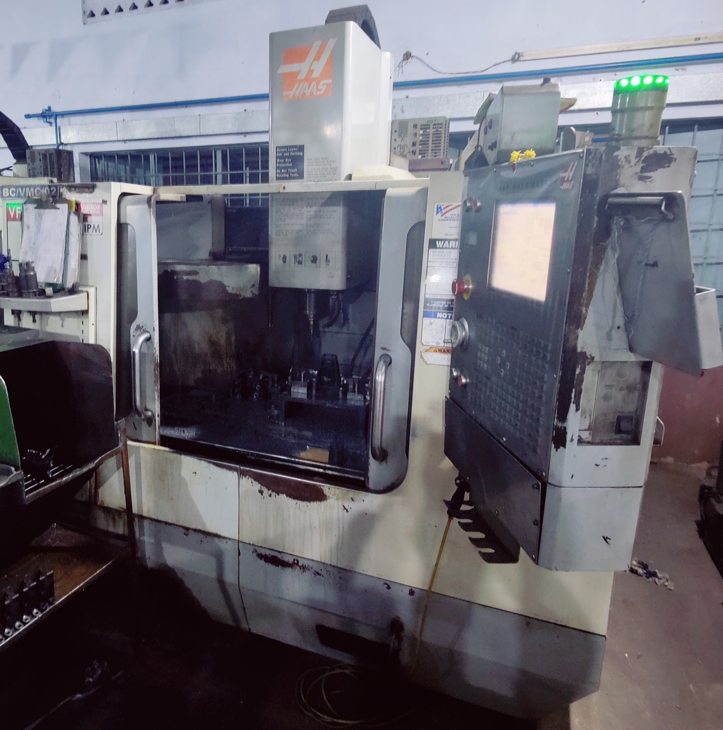
SAMPLES
CERTIFICATES AND AWARDS
SHOP FLOOR
About
MANUFACTURING FACILITY
MACHINE NAME :- VMC
MAKE & Model :- HAAS VF2 (USA)
CONTROL :- HAAS
CAPACITY :- 762 X 410 X 510 MM (Travel)

Slide 5
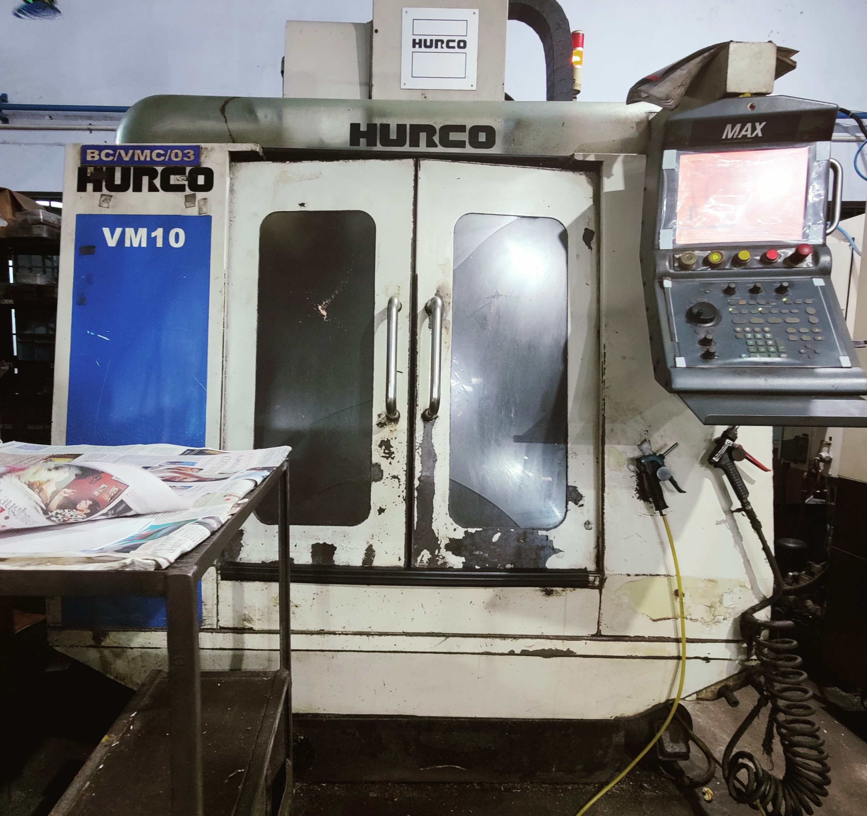
CERTIFICATES AND AWARDS
SHOP FLOOR
SAMPLES
About
MANUFACTURING FACILITY
MACHINE NAME :-VMC
MAKE &MODEL :- HURCO VM10 (USA)
CONTROL :- HURCO
CAPACITY :- 610 X 410 X510 MM

Slide 6
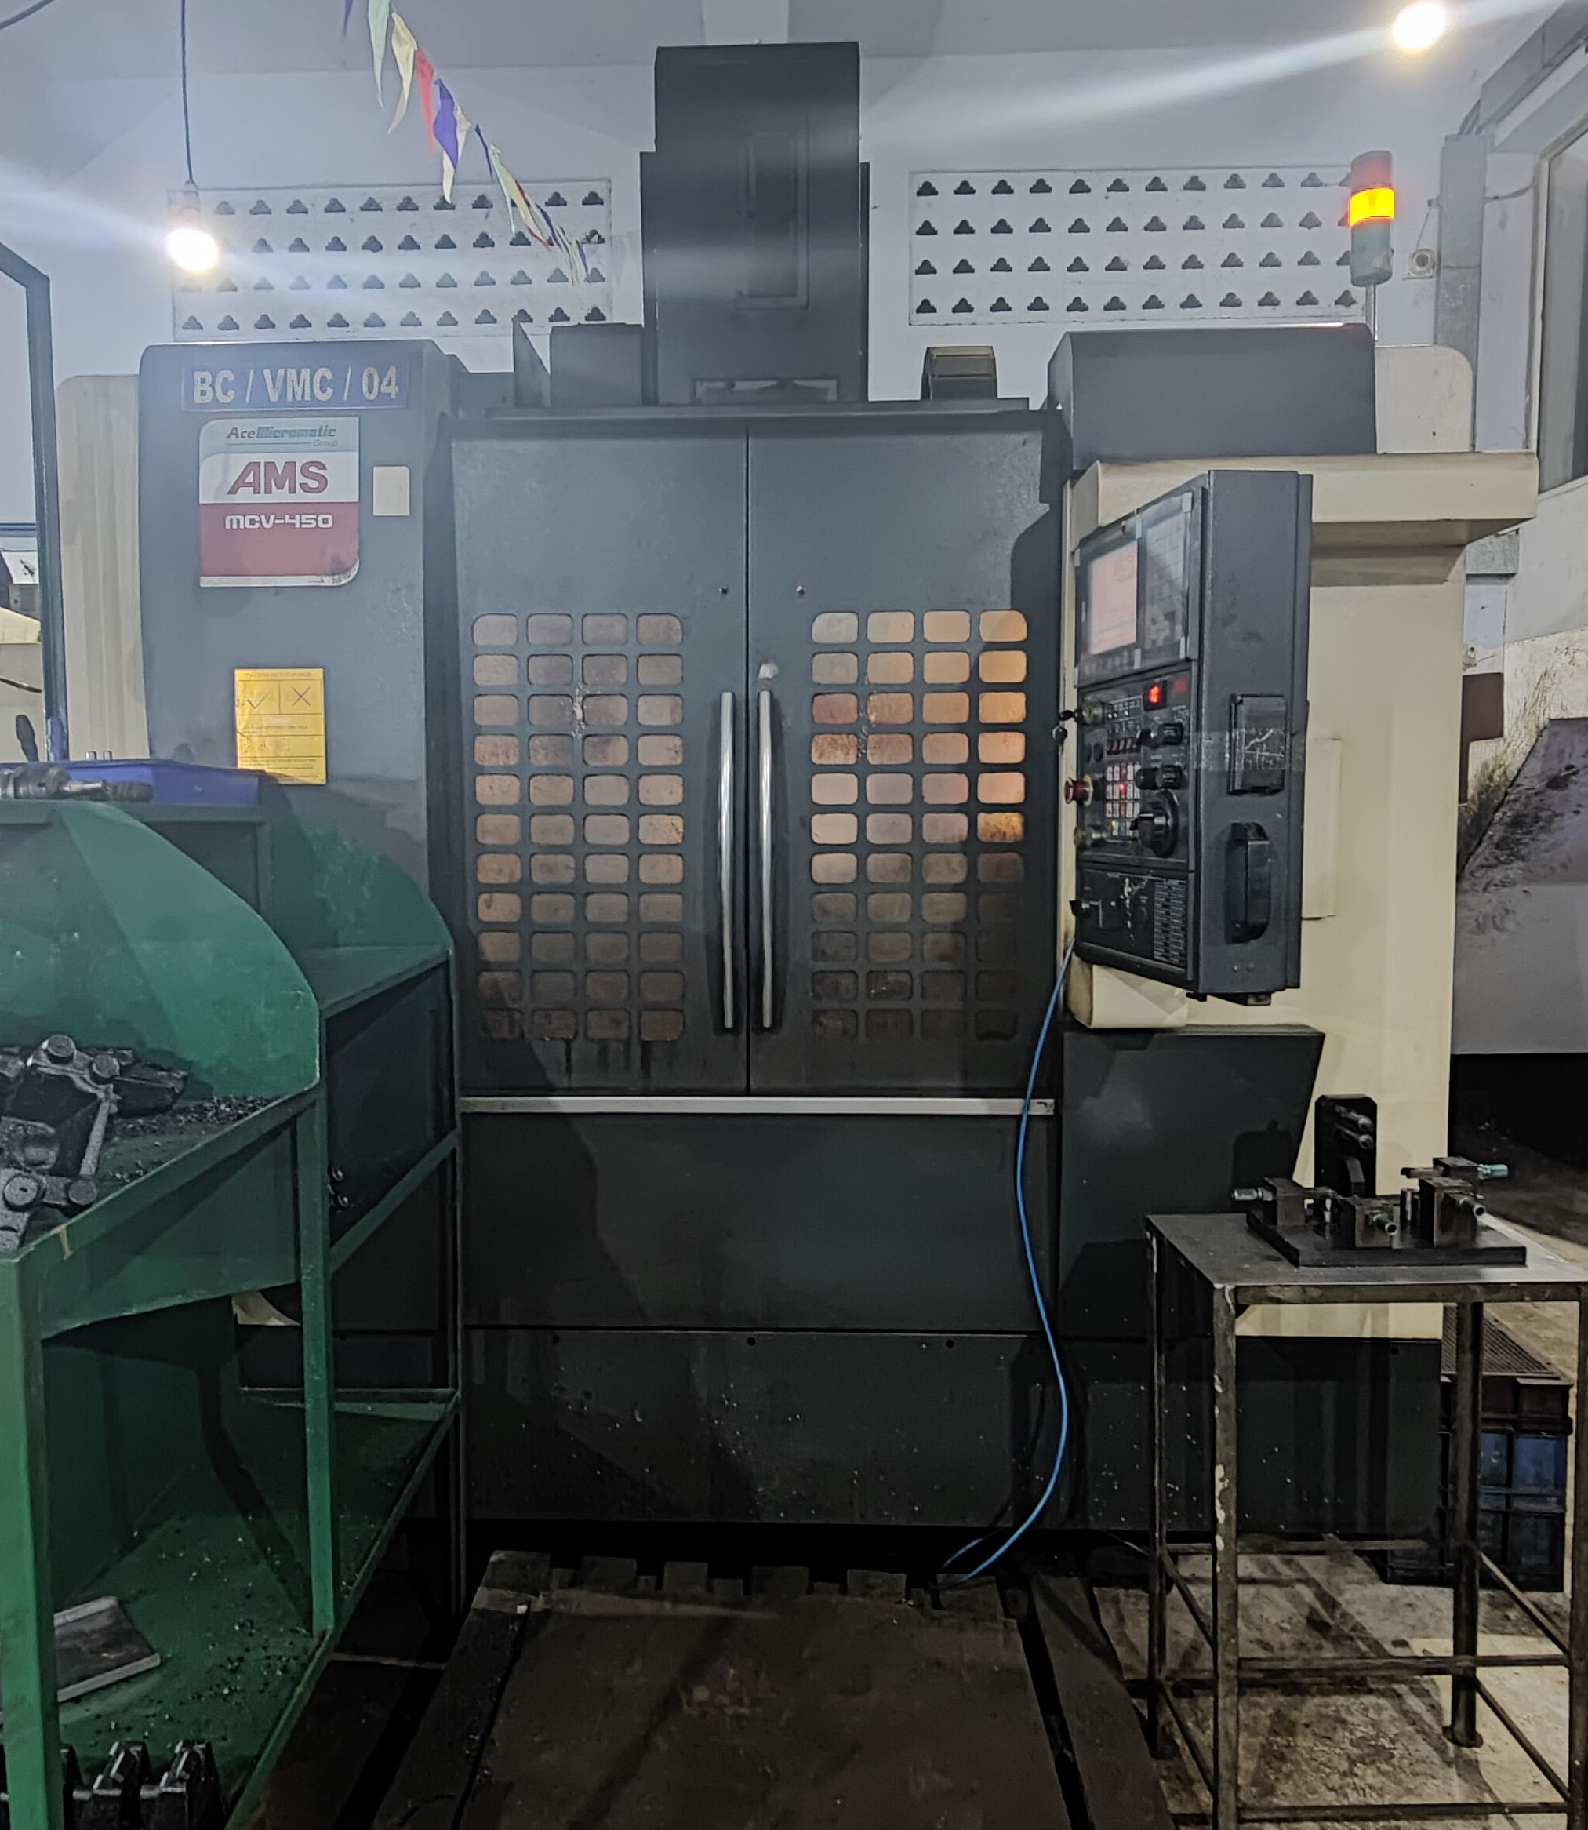
CERTIFICATES AND AWARDS
SHOP FLOOR
SAMPLES
About
MANUFACTURING FACILITY
MACHINE NAME :- VMC
MAKE &MODEL :- ACE &AMS MCV - 450
CONTROL :- FANUC
CAPACITY :- 800 X 450 X 510 MM (TRAVEL)
(With 4th AXIS And Hydraulic PowerPack)

Slide 7
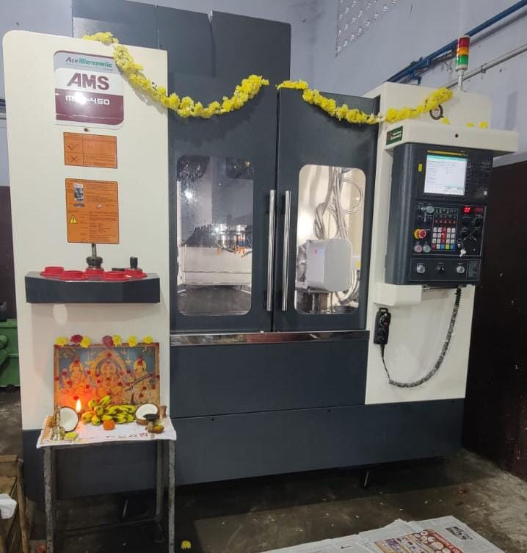
CERTIFICATES AND AWARDS
SHOP FLOOR
SAMPLES
About
MANUFACTURING FACILITY
BRAND NEW
MACHINE NAME :- VMC
CONTROL :- FANUC
MAKE &MODEL :- ACE & AMS MCV-450
CAPACITY :- 800X450X500MM
SPECIALITY :- (With 4TH AXIS AND Hydraulic PowerPack)

Slide 8
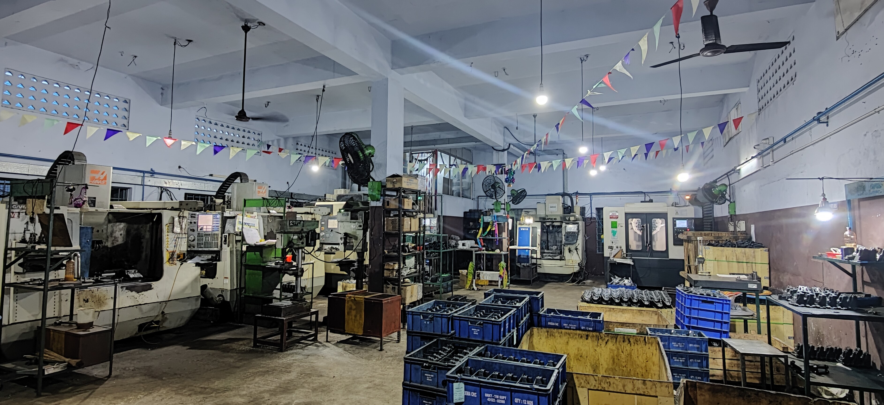
CERTIFICATES AND AWARDS
About
SAMPLES
SHOP FLOOR
MANUFACTURING FACILITY
VIEW FROM THE ENTRANCE

Slide 9
If you need any clarification, please feel free to contact us any time,
the numbers given Bellow, we will be happy to answer you.
Kindly advice on Vendor Registration in your Institution, and we are
waiting for your valuable enquiry and orders.
Thanking you in advance.
Yours faithfully ,
For Aako CNC.
P.SIMHADRI
PROPRIETOR
Cell No.9385503579
Mail ID : aako@gmail.com
Address :- NO.10,1st LANE ,MUNUSAMY STREET
VANAGARAM ROAD ,ATHIPET
CHENNAI-58
CERTIFICATES AND AWARDS
SAMPLES
About
CONTACT
SHOP FLOOR
MANUFACTURING FACILITY

